Slide 1
Foundation of Mathematics
Textbook or References:
Discrete Mathematics and its Applications by Kenneth. H. Rosen, 7th Edition
Discrete Mathematics with Application” by Susana. 4th edition, 2010

Slide 2
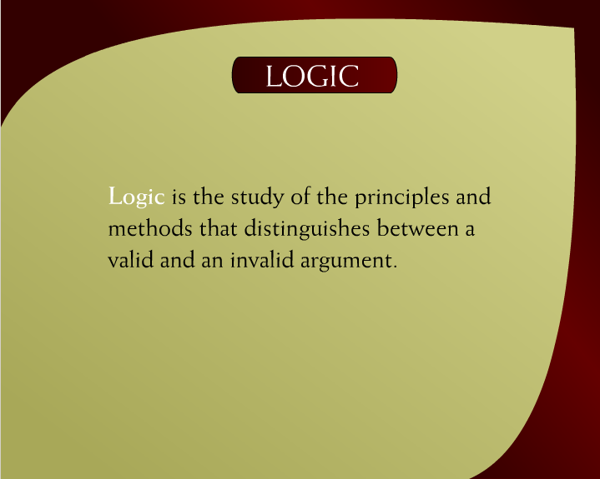
Logic – 7

Slide 3
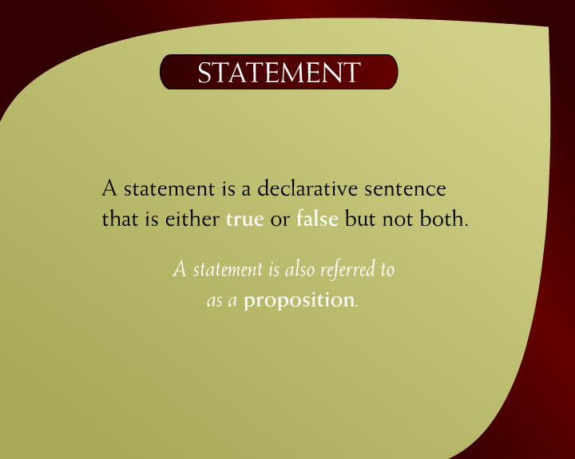
Statement – 8a

Slide 4
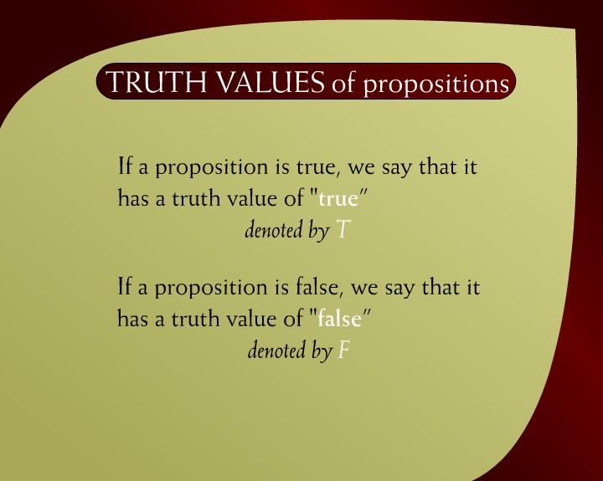
Truth Values of Propositions – 8c

Slide 5
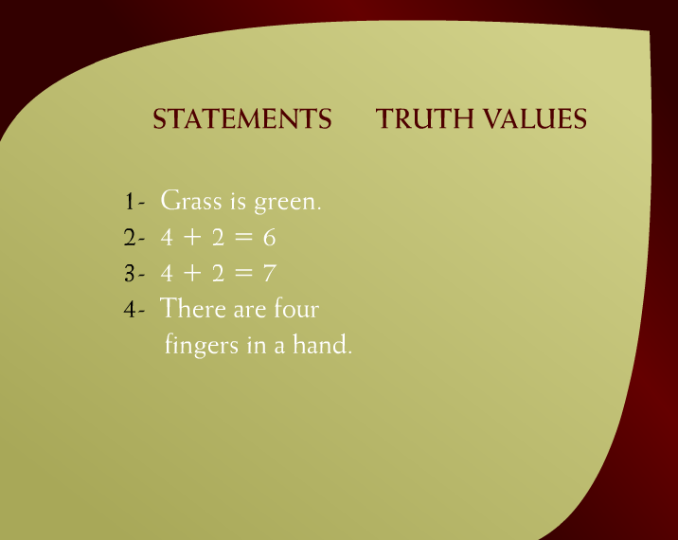
Statements & Truth Values – 9b
T
T
F
F

Slide 6
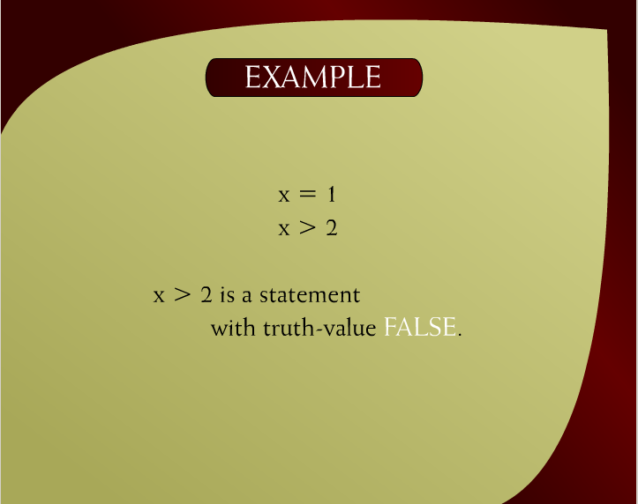
Example – 10b

Slide 7
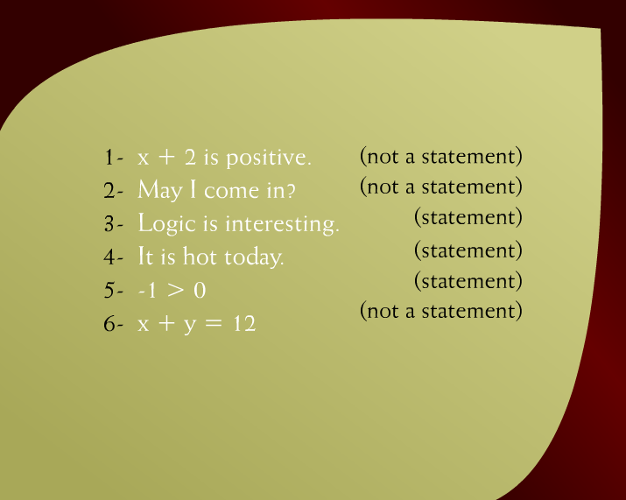
Example – 11b

Slide 8
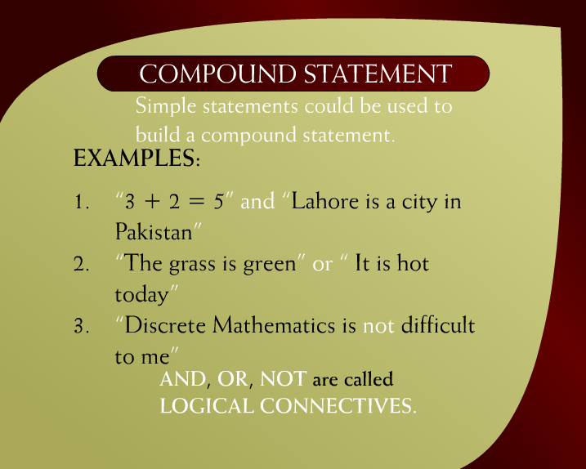
Compound Statement – 12a

Slide 9
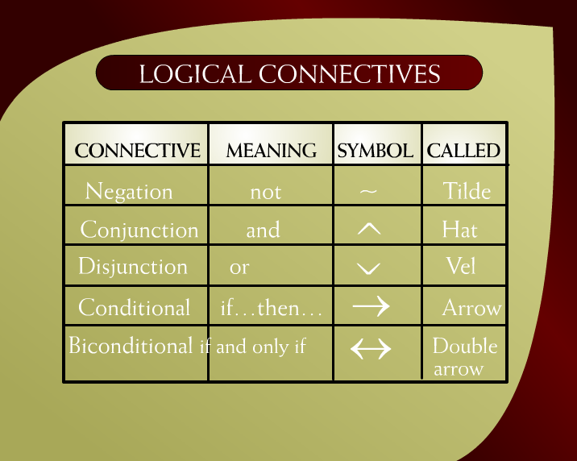
Logical Connectives – 14a

Slide 10
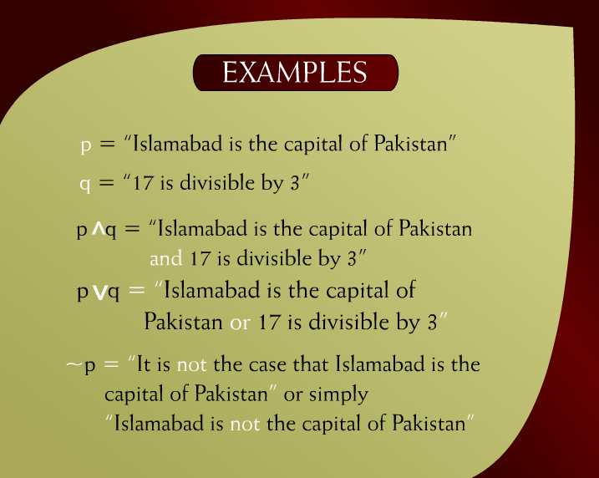
Examples – 14b

Slide 11
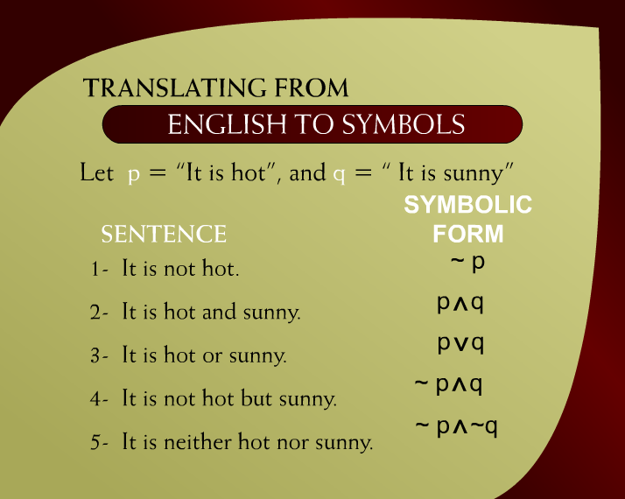
Translating from English to Symbols – 15

Slide 12
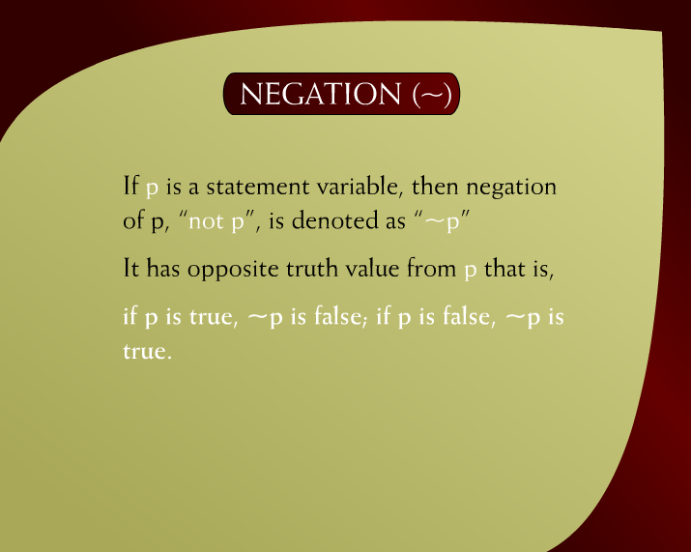
Negation – 19

Slide 13
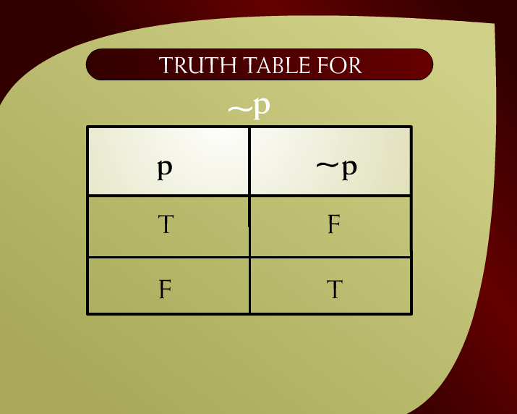
Truth Table for ~p – 20

Slide 14
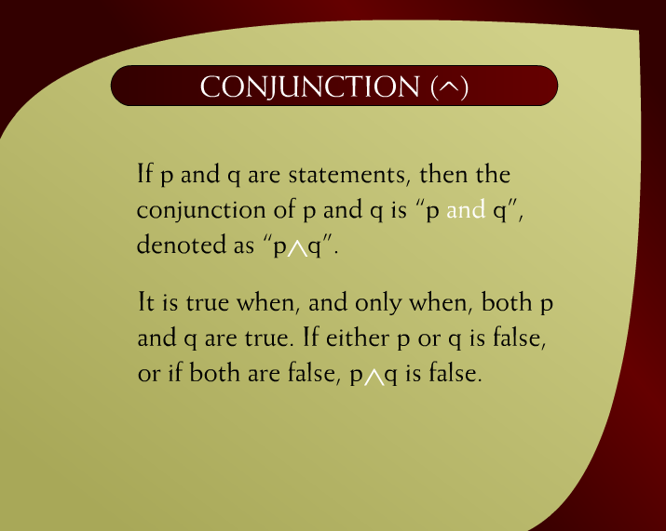
Conjunction – 21

Slide 15
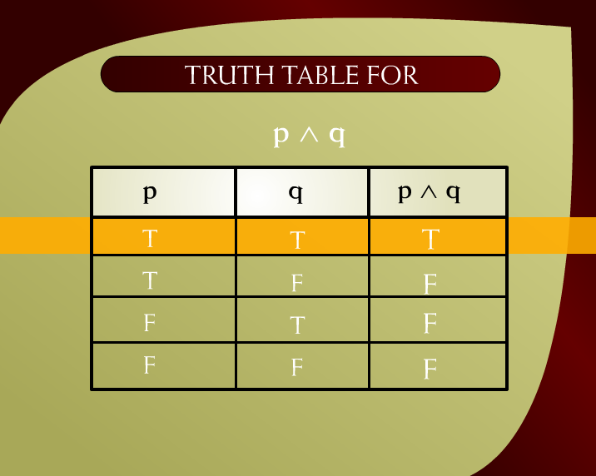
Truth Table for p ^ q – 22

Slide 16

Disjunction – 23

Slide 17
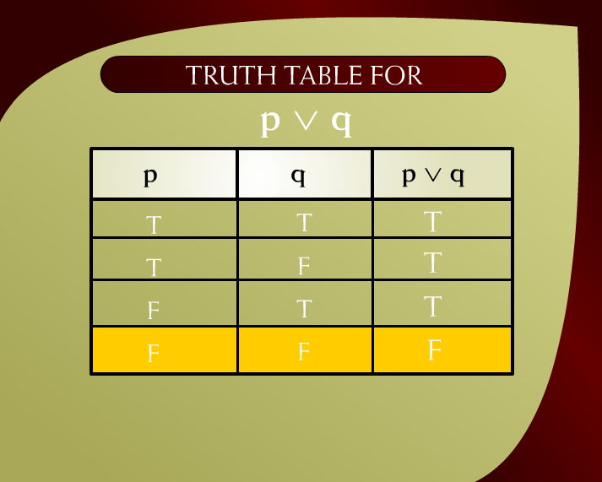
Truth Table for p q – 15

Slide 18
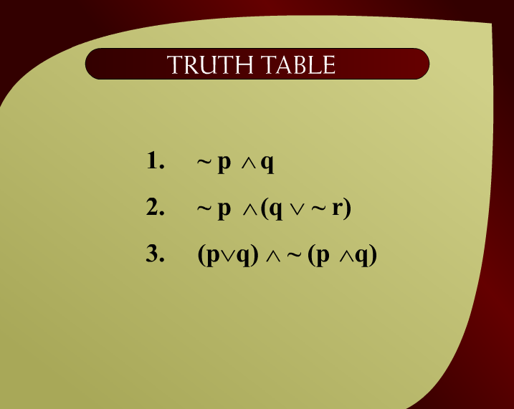
Truth Table

Slide 19
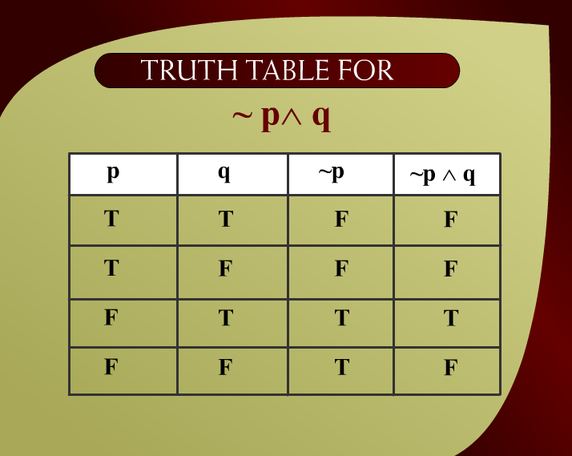
Truth Table for ~p^q – 2c

Slide 20
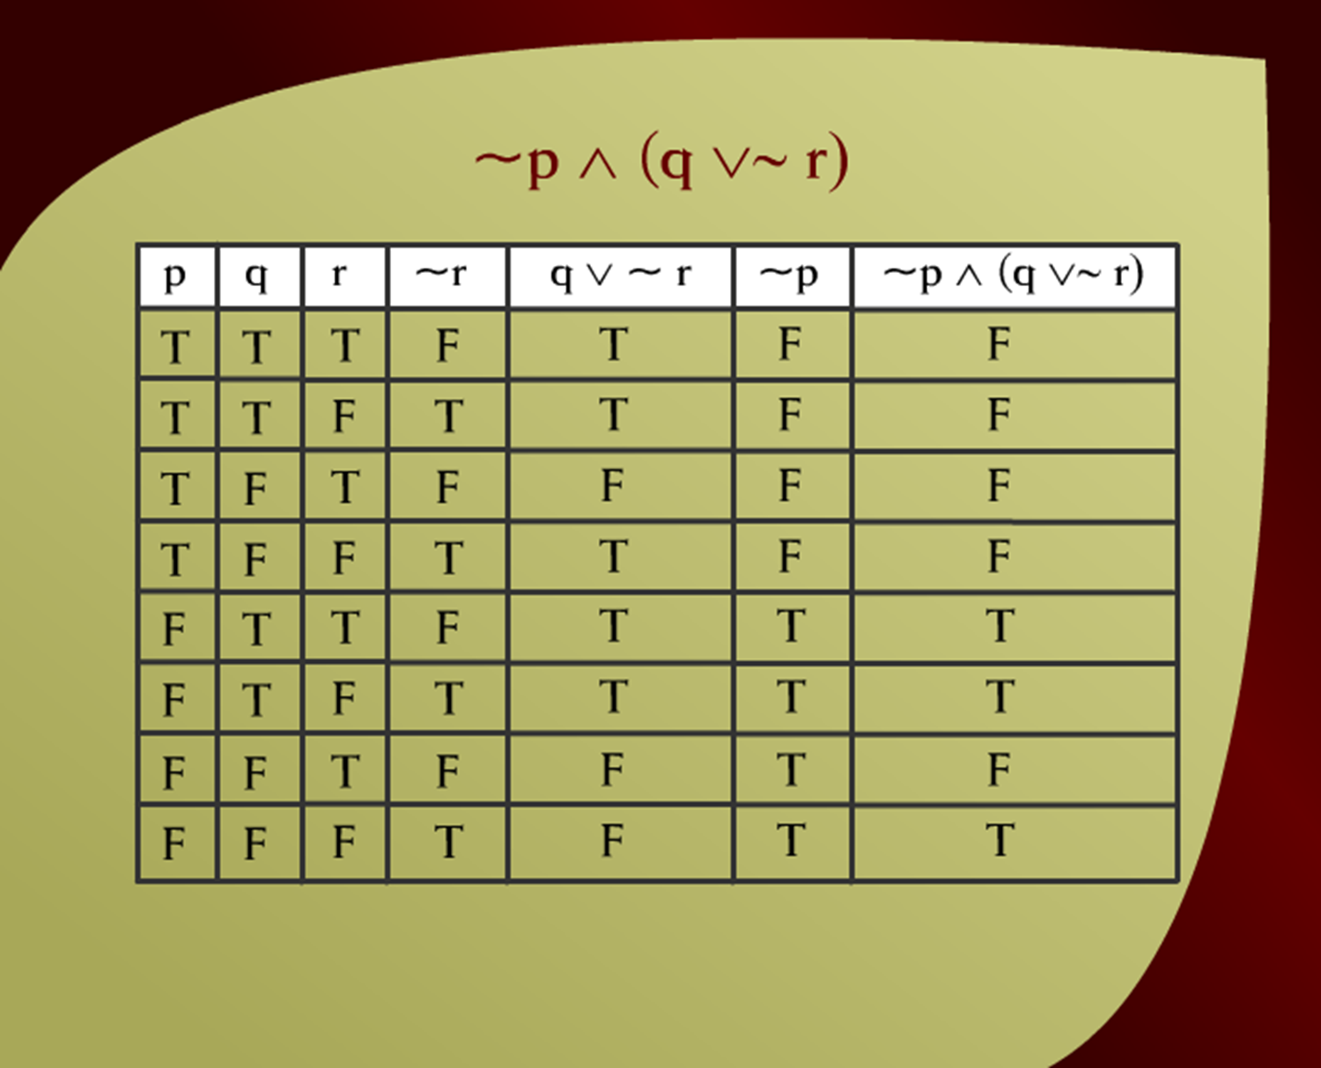
Truth Table for ~p (p v~ q) – 2 - 3e
v

Slide 21
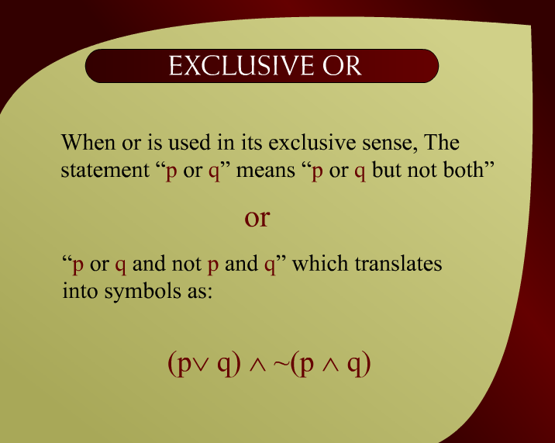
Exclusive OR – 2 - 5

Slide 22
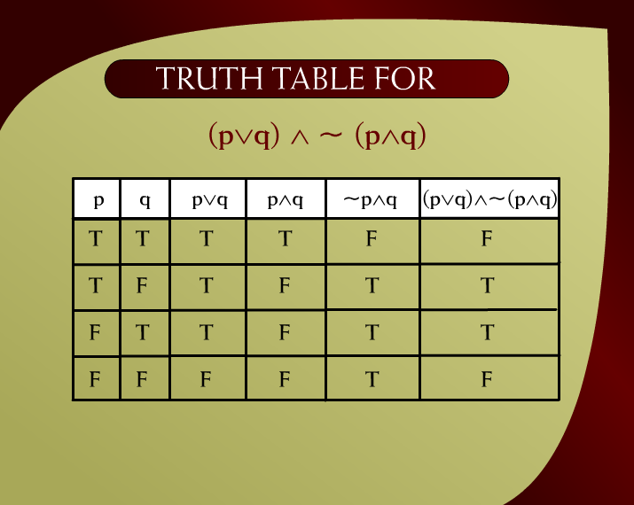
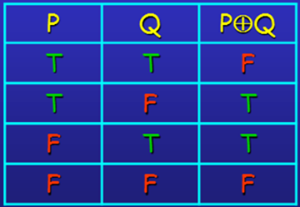
Truth Table for (pvq) ^~ (p^q) – 2 -4f

Slide 23
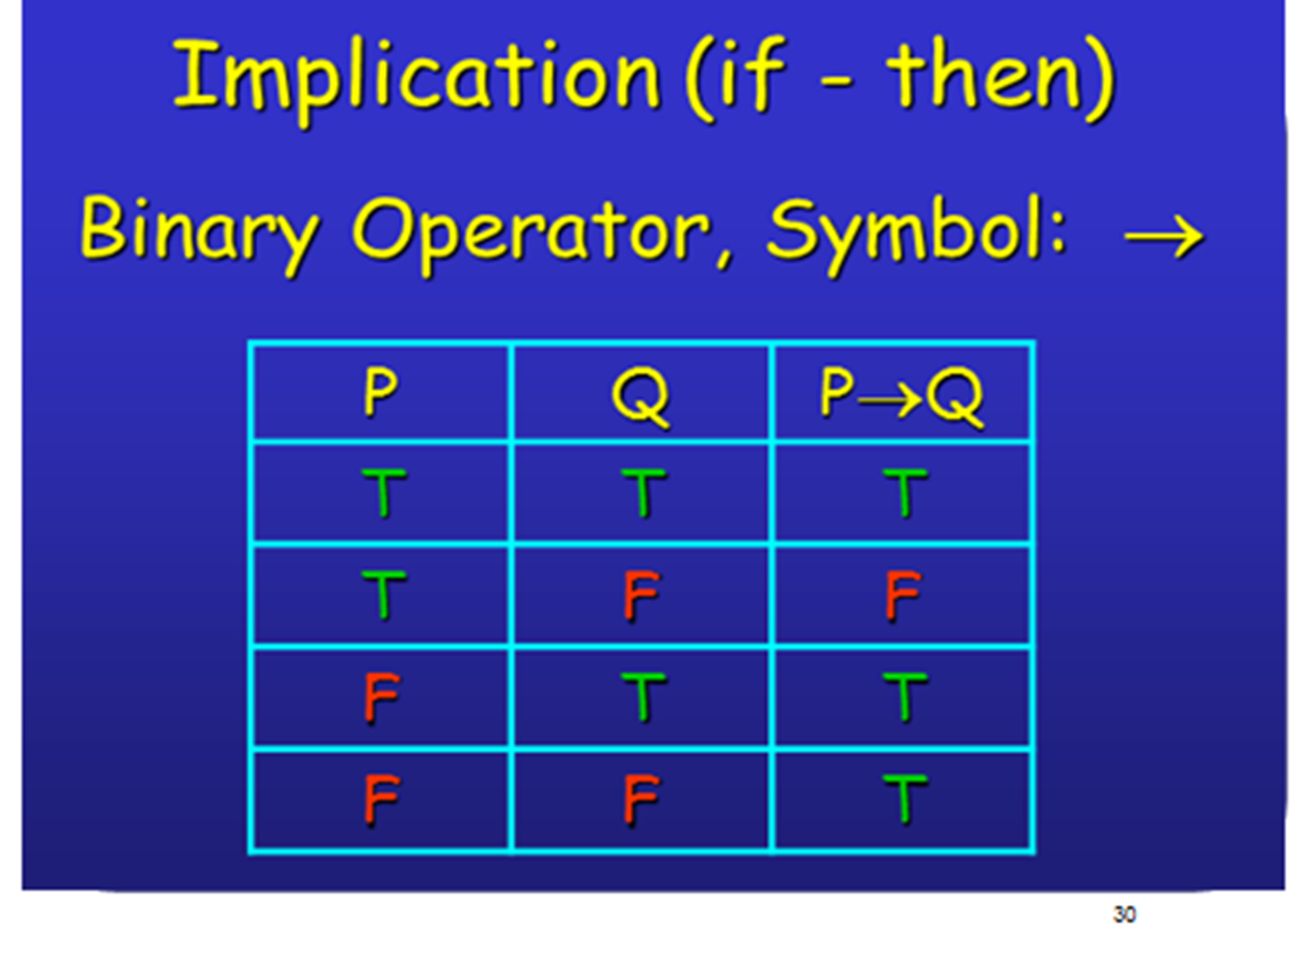

Slide 24
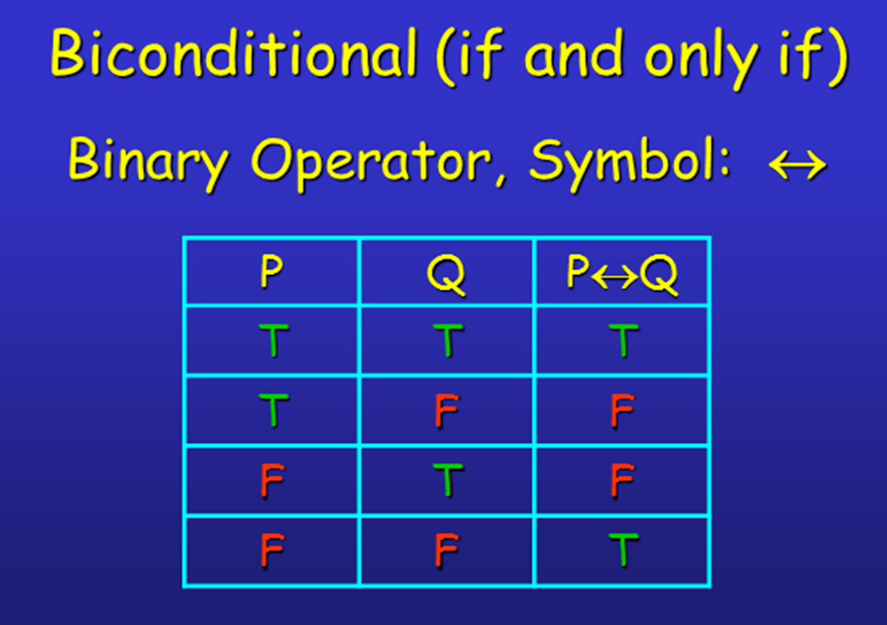

Slide 25
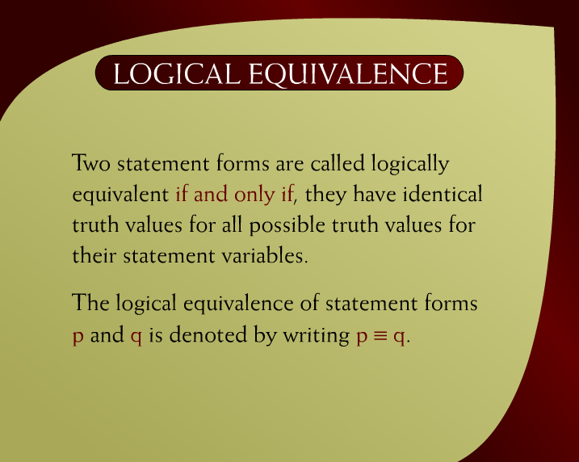
Logical Equivalence – 2 - 6

Slide 26
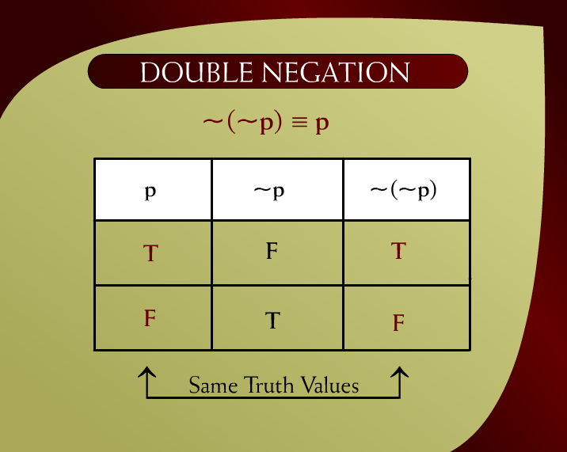
Double Negation ~(~p) ≡ p – 2 - 7

Slide 27
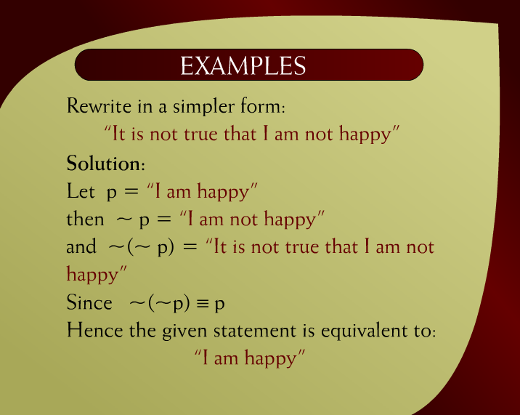
Examples – 2 - 12

Slide 28
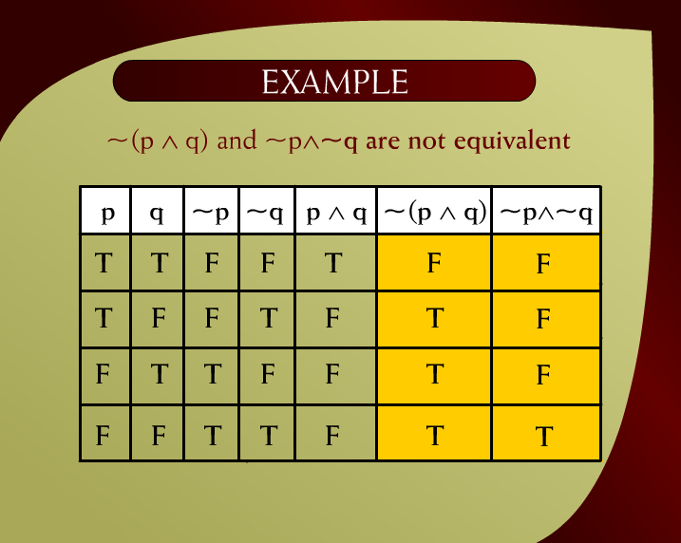
Example – 2 - 17e

Slide 29
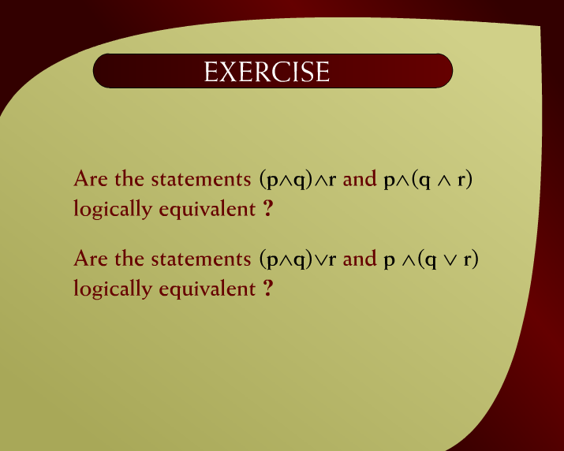
Exercise – 2 - 19

Slide 30
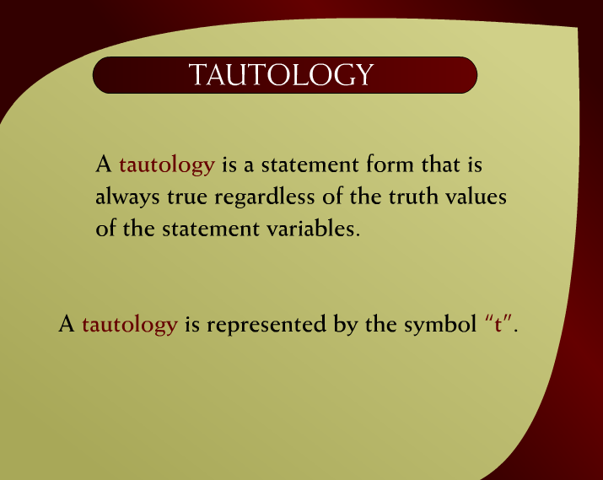
Tautology – 2 - 21

Slide 31
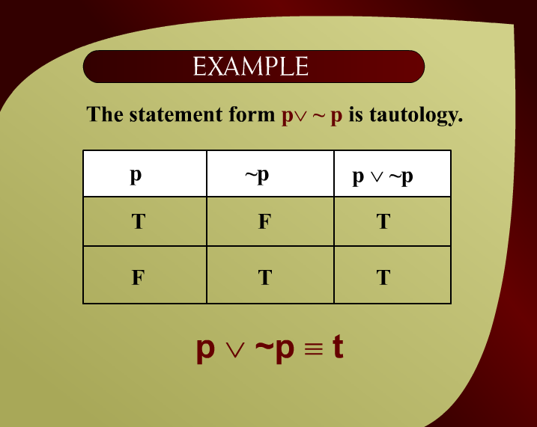
Example – 2 - 21a

Slide 32
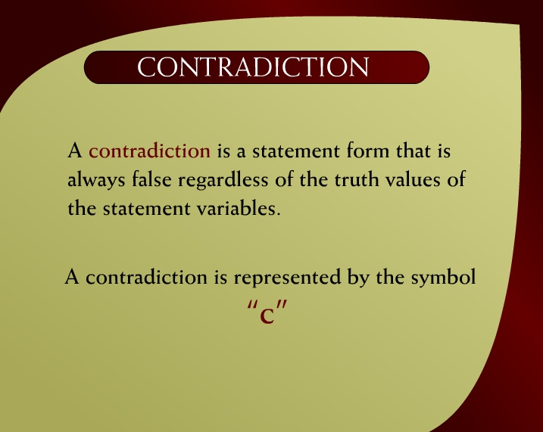
Contradiction – 2 - 22

Slide 33

Example – 2 - 22a

Slide 34
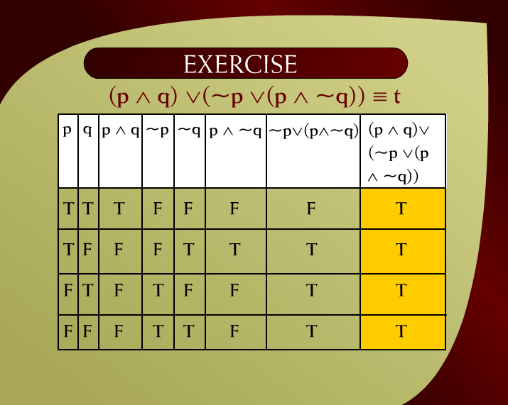
Exercise – 2 - 23

Slide 35
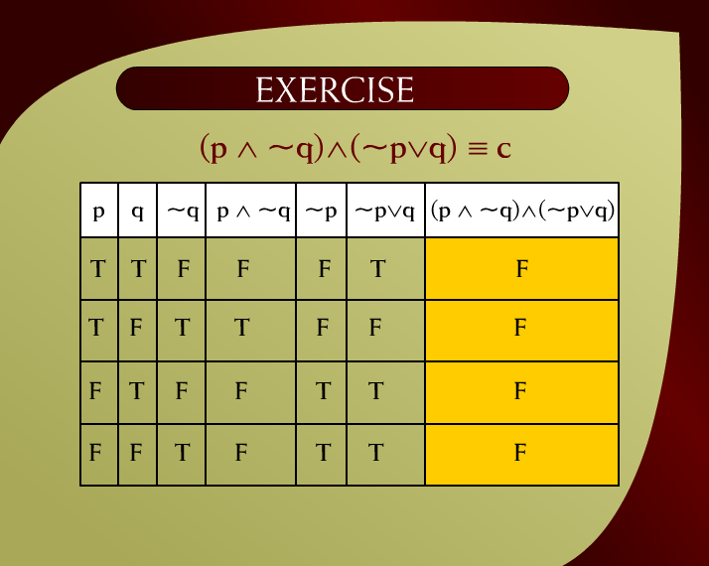
Exercise – 2 - 24

Slide 36
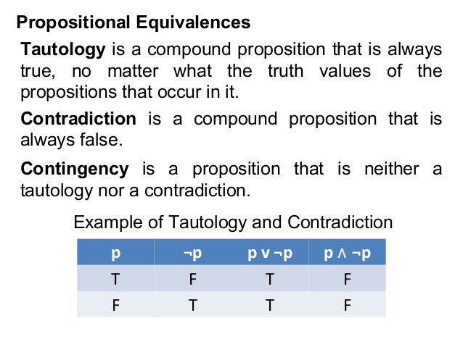

Slide 37
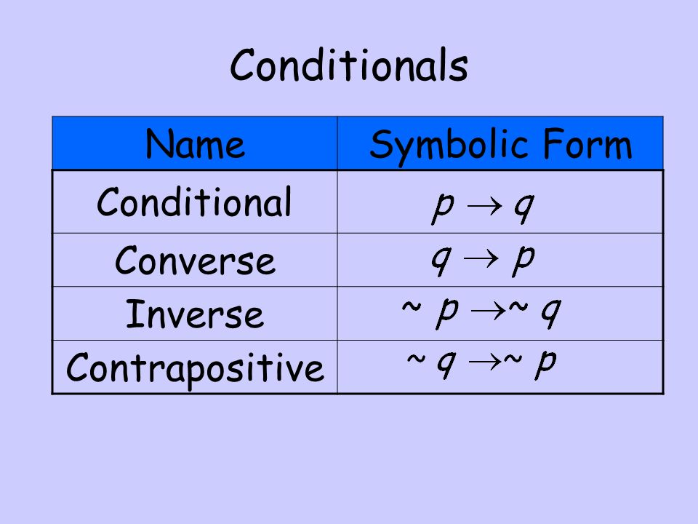

Slide 38
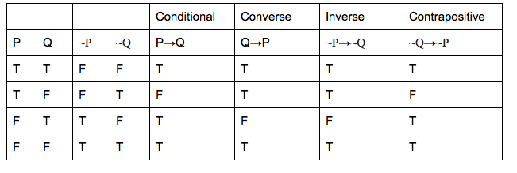

Slide 39
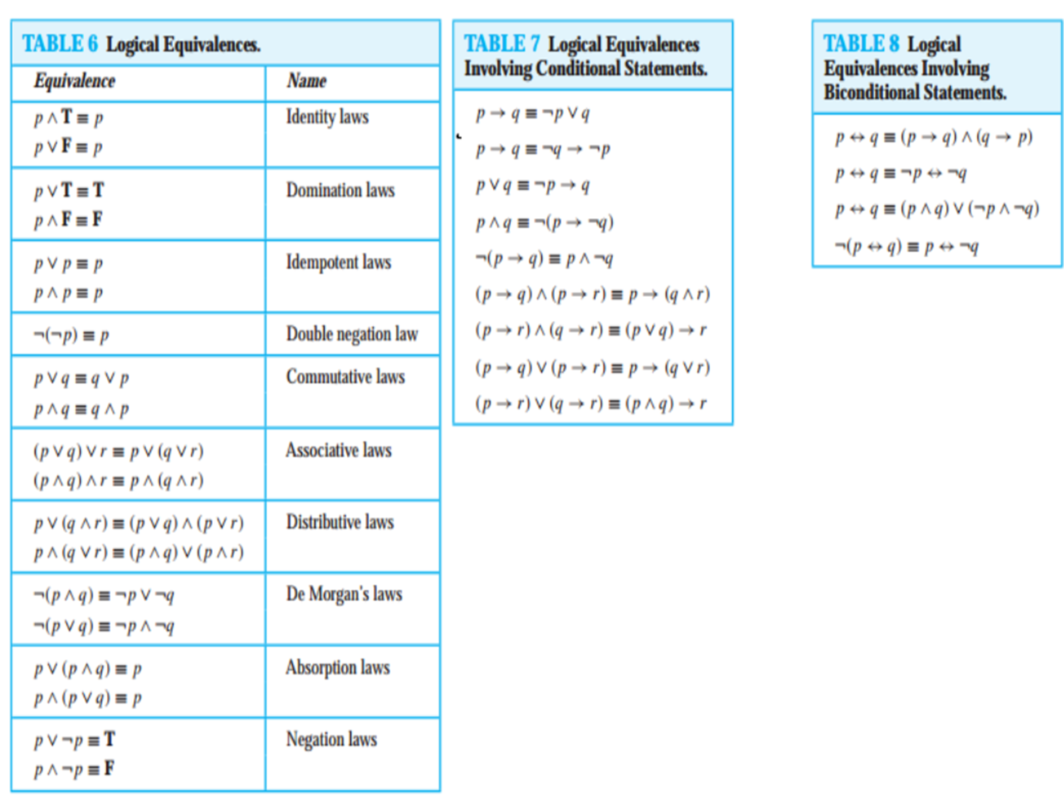

Slide 40
